Slide 1
F.O.S.S.A.
Open-source software to simplify DCLDE workflows

Slide 2
F.O.S.S.A.
PAMpal
Free Open-Source Software for Acoustics
Series of R packages developed at SWFSC
Streamline and standardize processing workflow for acoustics
R package created to work with PAMGuard data
Created standard data structure for acoustic data
Keeps track of metadata
Makes it easier to work with acoustic data and do common tasks

Slide 3
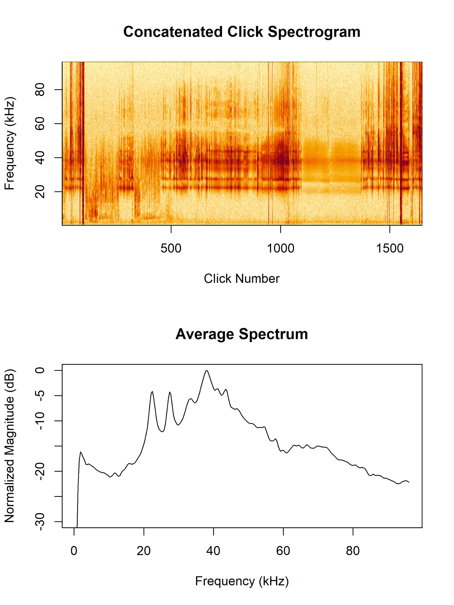


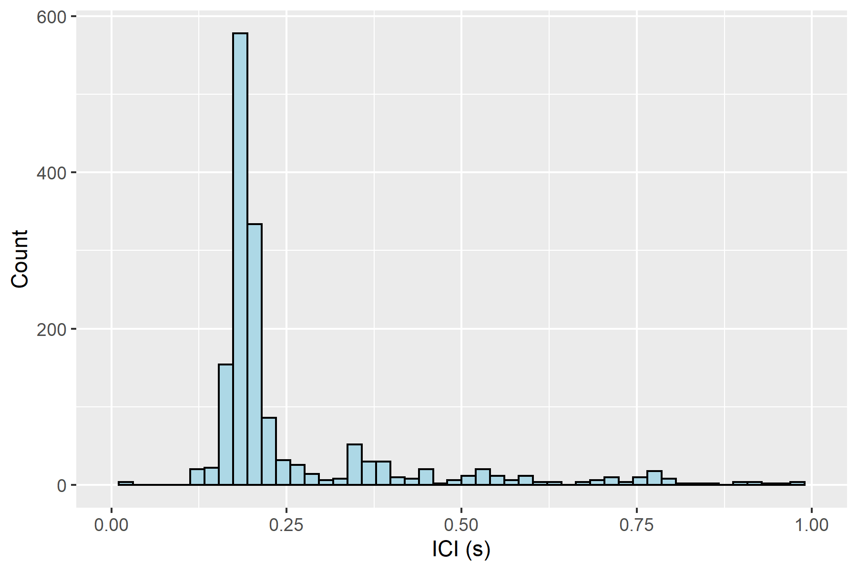
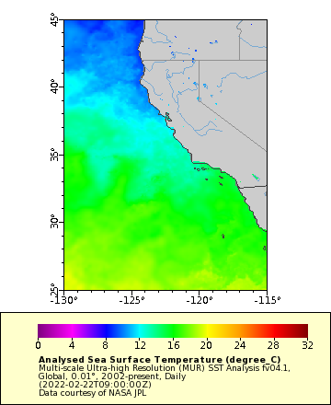
PAMpal One Liners

Slide 4
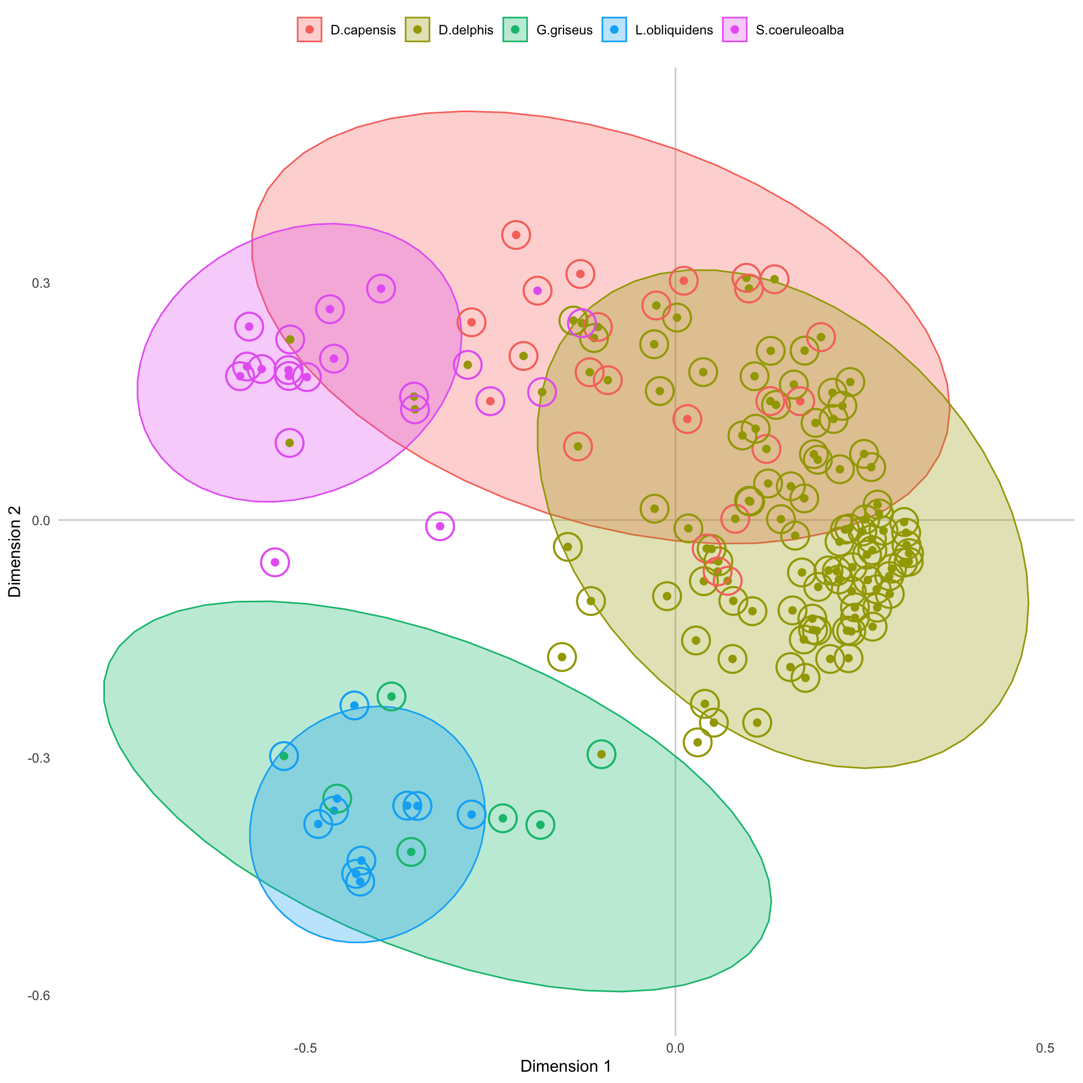
BANTER
R package developed by Eric Archer
Hierarchical random forest classifier
Event-level and detection-level information
Multiple people presenting results at DCLDE

Slide 5
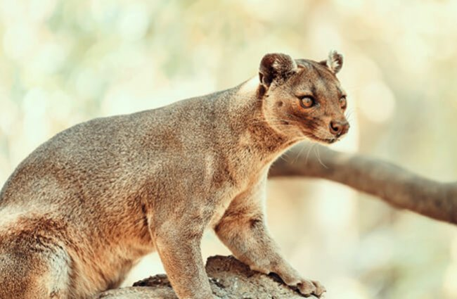
FOSSA’s Role
Event + detector structure is not straightforward
PAMpal makes this a single line of code
Checks for potential errors
Ease of use -> increased adoption -> better product
We want to make this happen for more models in the future

Slide 6
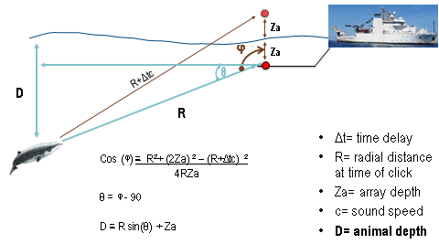
Dive Depth Estimation
Project with Annamaria DeAngelis & Annabel Westell
Estimate dive depth of beaked whale + sperm whale using echoes
Credit: Annamaria DeAngelis

Slide 7
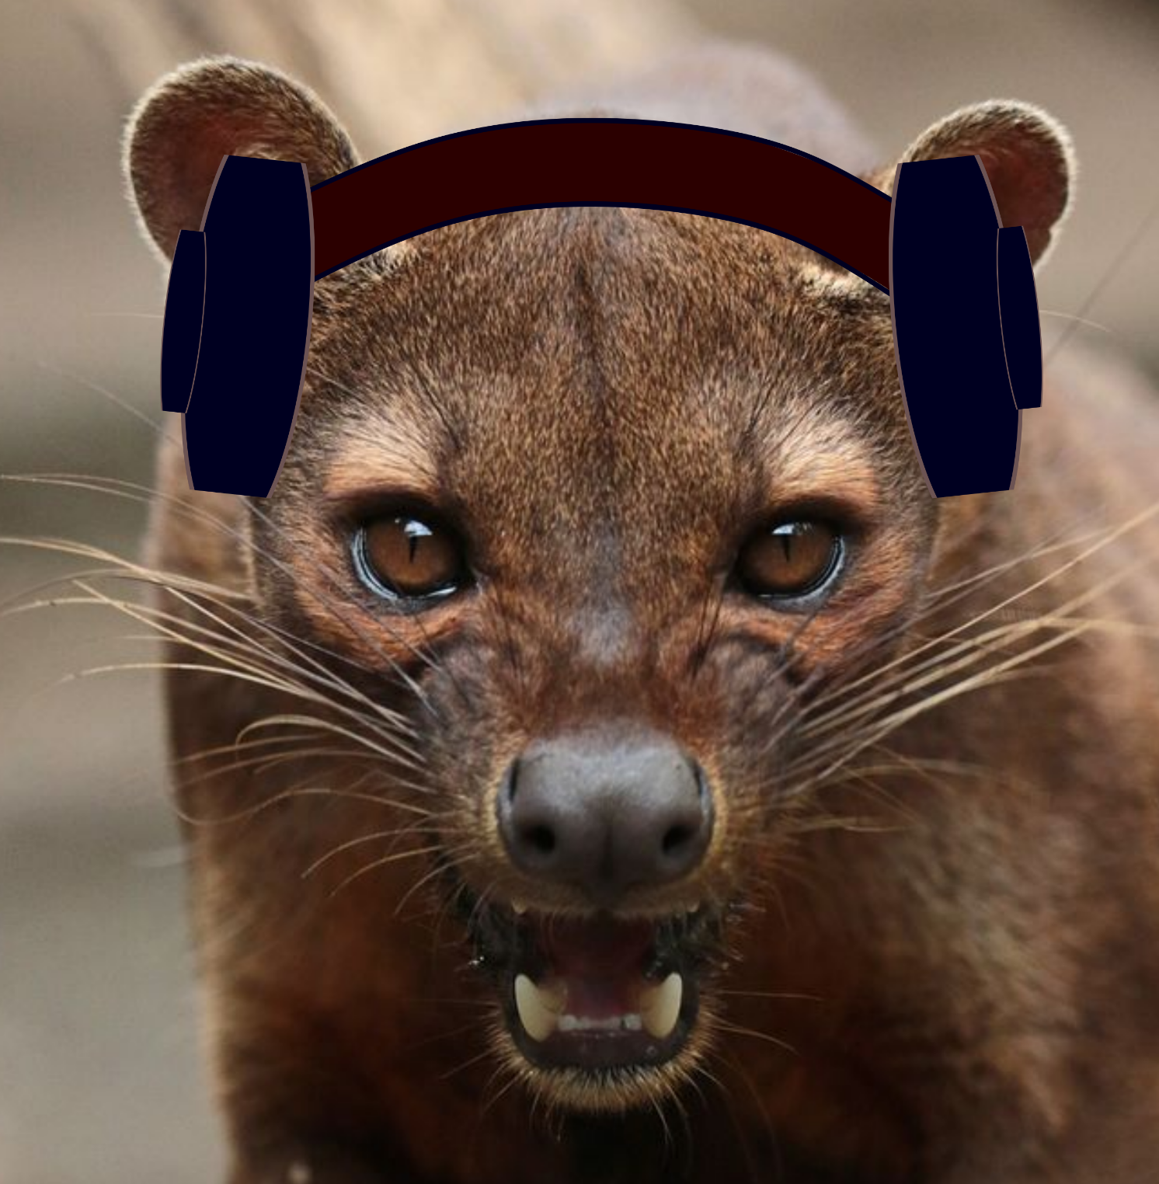

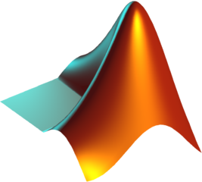


FOSSa’s Role
+
Manual Labor
Notes:
PG species id and processing, raven wav clips

Slide 8

FOSSa’s Role
Replaced many hours of manual labor
PAMpal data structure makes it easier to track metadata
Removing extra steps means it easier to reproduce
Eventually hope to replace MATLAB portion with R, but PAMpal can still be useful to streamline part of a workflow creating intermediate data products (wav files, CSVs)
Notes:
Done once, done for everyone

Slide 9
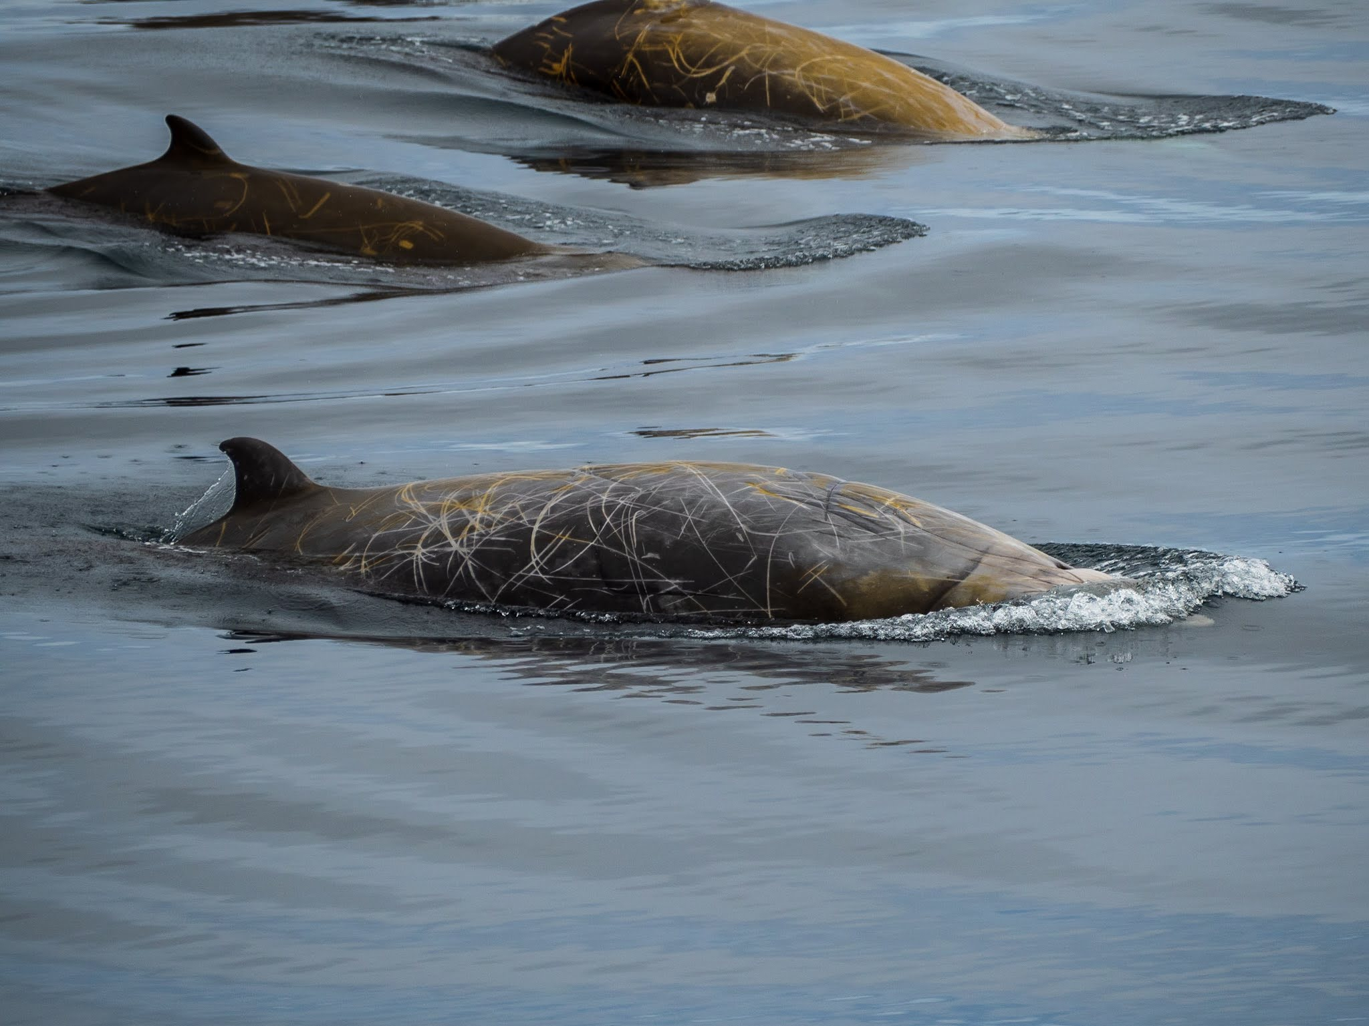
Ziphius Abundance Estimation
Project with Jay Barlow and Jeff Moore
Estimate the density and abundance of Ziphius using received angles of clicks

Slide 10
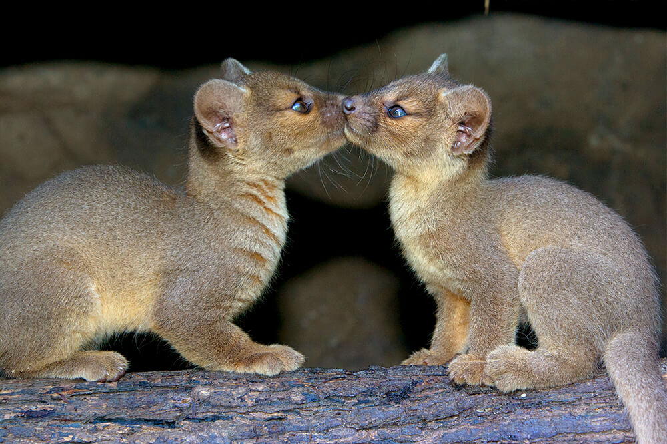
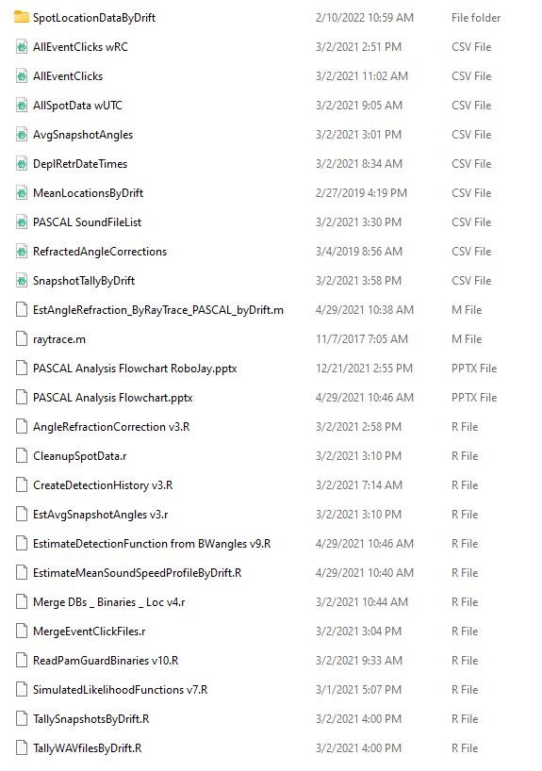
FOSSa’s Role
Goal is to reproduce for future surveys
Currently…difficult
Half of the steps already done by PAMpal
Needs soundspeed profile, easy to accomplish with existing FOSSA tools

Slide 11

Acknowledgements
Eric Archer & Shannon Rankin
Annamaria DeAngelis & Annabel Westell
Jay Barlow & Jeff Moore
Simone Baumann-Pickering, Emily Griffiths, Julie Oswald, Michael Oswald
Doug Gillespie & Jamie Macaulay
NOAA’s Advanced Sampling Technology Working Group
Bureau of Ocean Energy Management through Interagency Agreement M20PG00013

Slide 12
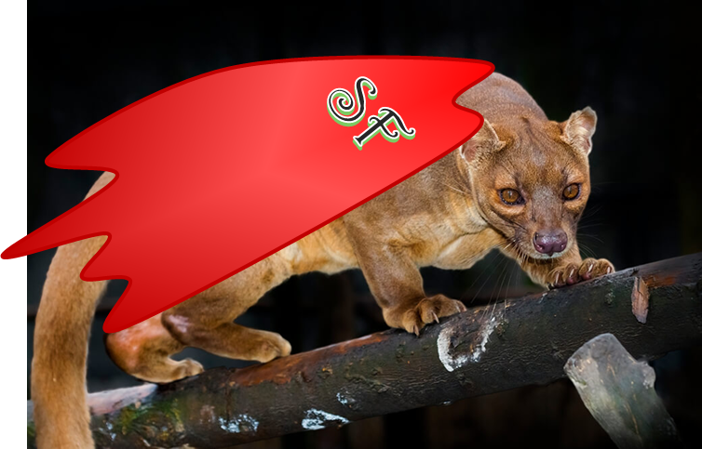
What can FOSSA do for you?
Email me! taiki.sakai@noaa.gov
Tutorial website: https://taikisan21.github.io/PAMpal/
Channel in PAMGuard Slack: https://join.slack.com/t/pamguard/shared_invite/zt-14d8kwgvp-QBzqPnu8qOpK9gQfjejc1w (or e-mail me for a link)

